Slide 1
Data Analysis & Visualization — Introduction to Data and Visualization Tools—
By Dr. Harriet Sibitenda

Slide 2
Introduction
Data analysis is the process of extracting insights and meaning from data by analyzing and interpreting it. In today's world, data is abundant, and data analytics is becoming increasingly important across various fields, including business, healthcare, education, and many others. If you are a beginner in data analytics, this guide will help you get started.
The data can be of different types, including structured, unstructured, and semi-structured. Structured data is organized and easily searchable, like data in a spreadsheet. Unstructured data, like text or images, is not easily searchable, and semi-structured data is a combination of both.
Some of the commonly used data analysis techniques include descriptive analysis, predictive analysis, and prescriptive analysis.

Slide 3
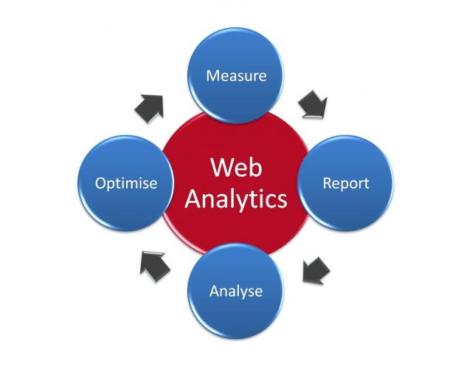
Data Analysis tools
To analyze data, you need to use tools that can help you process and manipulate data. Some of the commonly used data analytics tools include Excel, R, Python, SQL, Tableau, and Power BI. Excel is a widely used tool for data analytics, and it is easy to use, especially for beginners. R and Python are programming languages that are commonly used for data analytics. SQL is a language used to query databases, and Tableau and Power BI are tools used for data visualization.

Slide 4
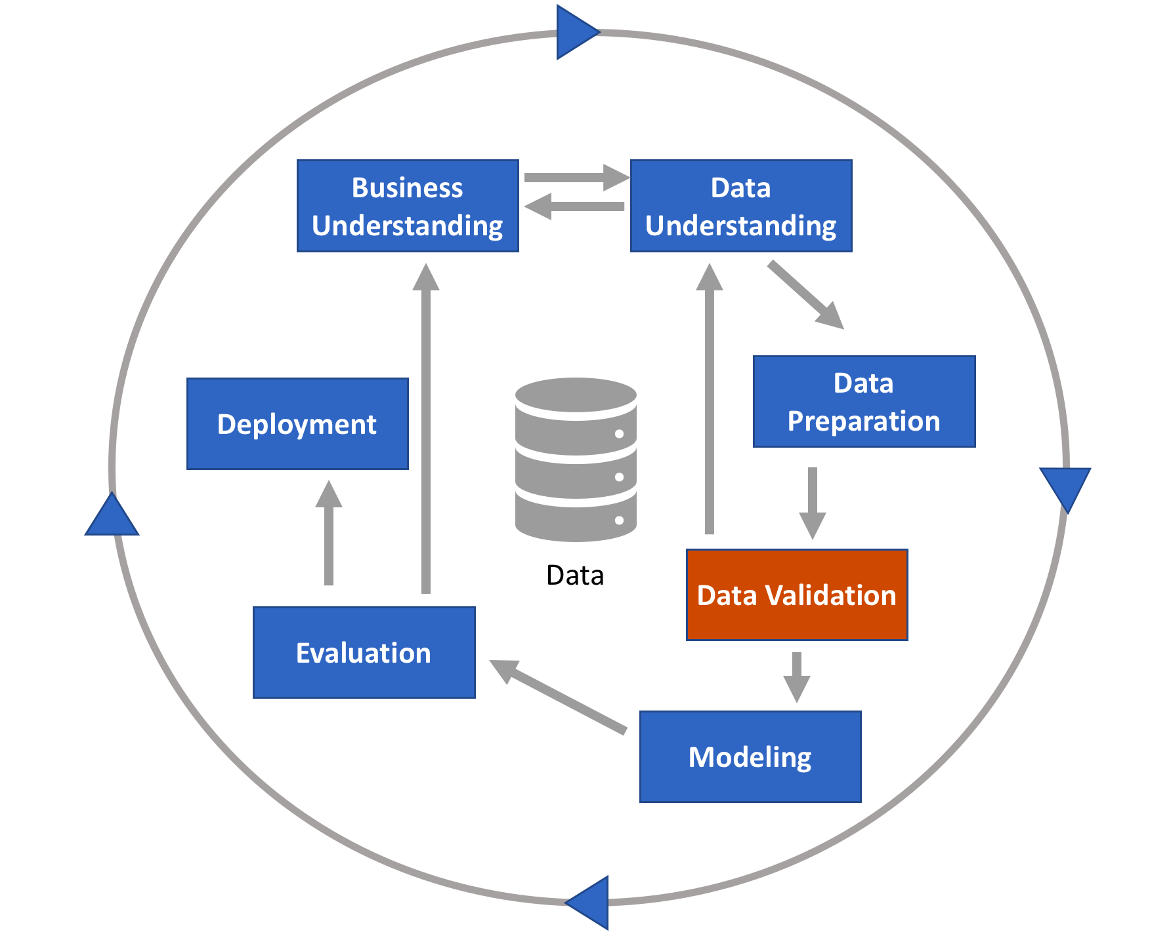
Data Preparation
Before you start analyzing data, you need to prepare it. Data preparation involves cleaning, transforming, and organizing data. Cleaning data involves removing or fixing errors, like missing values or incorrect data. Transforming data involves converting data from one form to another, like converting a text field to a numerical field. Organizing data involves structuring the data in a way that makes it easy to analyze.

Slide 5
Data Visualization
Machine Learning
Data visualization involves representing data using charts, graphs, and other visual tools. Data visualization is important because it helps you understand and communicate insights and meaning from the data. Some of the commonly used data visualization tools include Tableau, Power BI, and Excel. When creating visualizations, it is important to choose the right type of chart or graph that can best represent the data
Machine learning is a subfield of data analytics that involves using algorithms to make predictions and decisions based on data. Machine learning algorithms can be used for tasks like image recognition, language translation, and fraud detection. Some of the commonly used machine learning algorithms include linear regression, logistic regression, and decision trees.

Slide 6
Data Visualization: What is it?
Data visualization is the graphical representation of information and data.
By using visual elements like charts, graphs, and maps, data visualization tools provide an accessible way to see and understand trends, outliers, and patterns in data.
It provides an excellent way for employees or business owners to present data to non-technical audiences without confusion.
Helps too make decisions and use visuals to tell stories of when data informs the who, what, when, where, and how.
While traditional education typically draws a distinct line between creative storytelling and technical analysis, the modern professional world also values those who can cross between the two:
data visualization sits right in the middle of analysis and visual storytelling.
A good visualization tells a story, removing the noise from data and highlighting useful information.

Slide 7
General Types of Visualizations
Chart: Information presented in a tabular, graphical form with data displayed along two axes. Can be in the form of a graph, diagram, or map.
Table: A set of figures displayed in rows and columns.
Graph: A diagram of points, lines, segments, curves, or areas that represents certain variables in comparison to each other, usually along two axes at a right angle.
Geospatial: A visualization that shows data in map form using different shapes and colors to show the relationship between pieces of data and specific locations.
Infographic: A combination of visuals and words that represent data. Usually uses charts or diagrams.
Dashboards: A collection of visualizations and data displayed in one place to help with analyzing and presenting data.

Slide 8
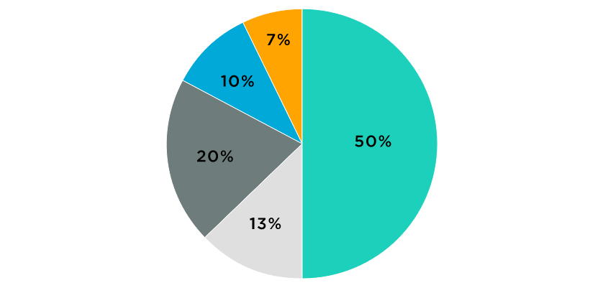
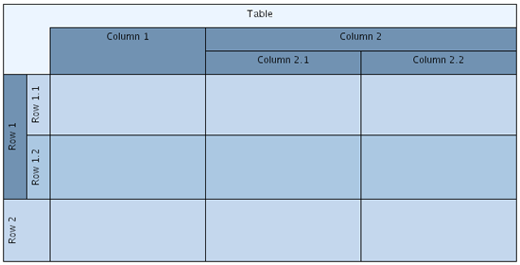
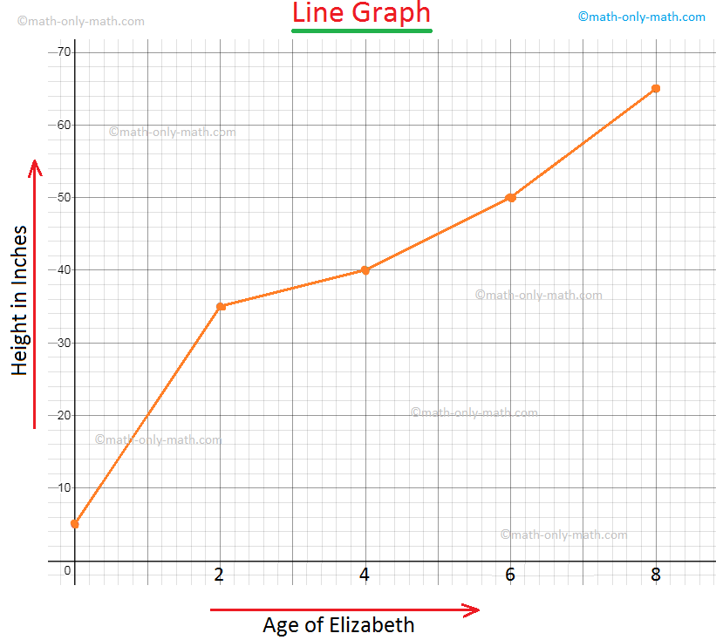

Pie Chart
Table
Graph
Geospatial Graph

Slide 9
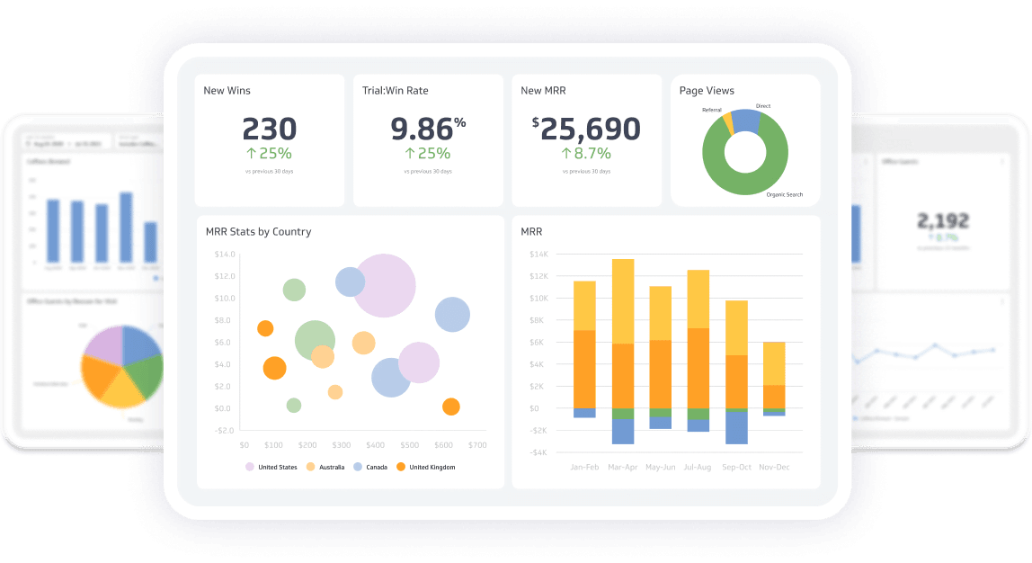
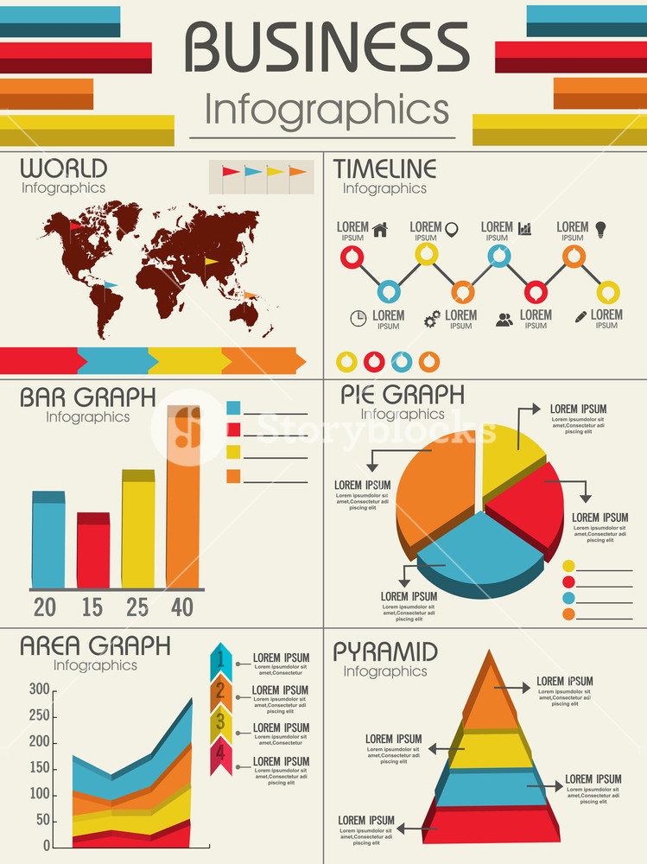

Slide 10
Specific Examples:
Area Map: A form of geospatial visualization, used to show specific values set over a map of a country, state, any location.
Bar Chart: Bar charts represent numerical values compared to each other.
Box-and-whisker Plots: These show a selection of ranges (the box) across a set measure (the bar).
Bullet Graph: A bar marked against a background to show progress against a goal, denoted by a line on the graph.
Gantt Chart: Typically used in project management, Gantt charts are a bar chart depiction of timelines and tasks.
Heat Map: A type of geospatial visualization in map form which displays specific data values as different colors.
Highlight Table: A form of table that uses color to categorize similar data, allowing the viewer to read it more easily.
Histogram: A type of bar chart that split a continuous measure into different bins to help analyze the distribution.
Pie Chart: A circular chart with triangular segments that shows data as a percentage of a whole.
Treemap: A type of chart that shows different, related values in the form of rectangles nested together.

Slide 11
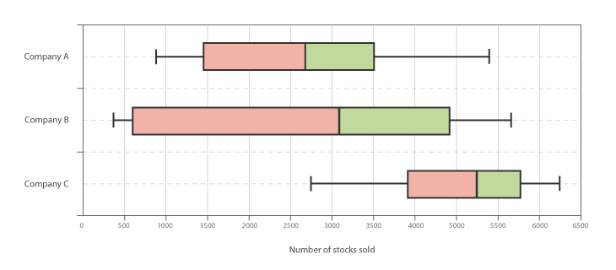

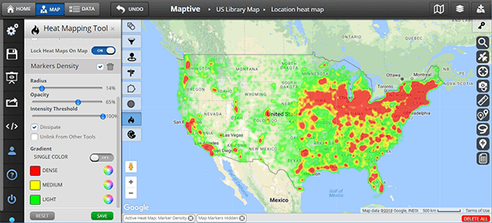
Box & Whisker Plot

Slide 12
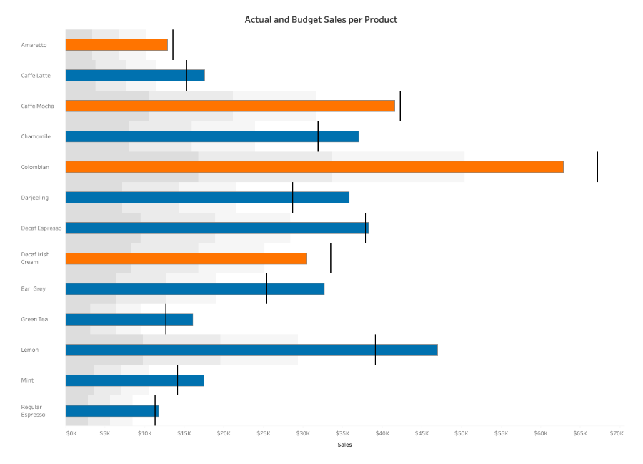
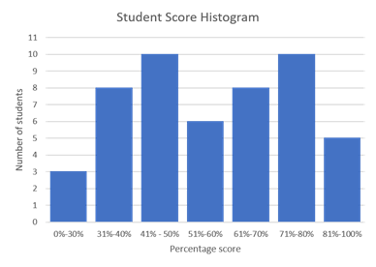
Bullet Graph

Slide 13
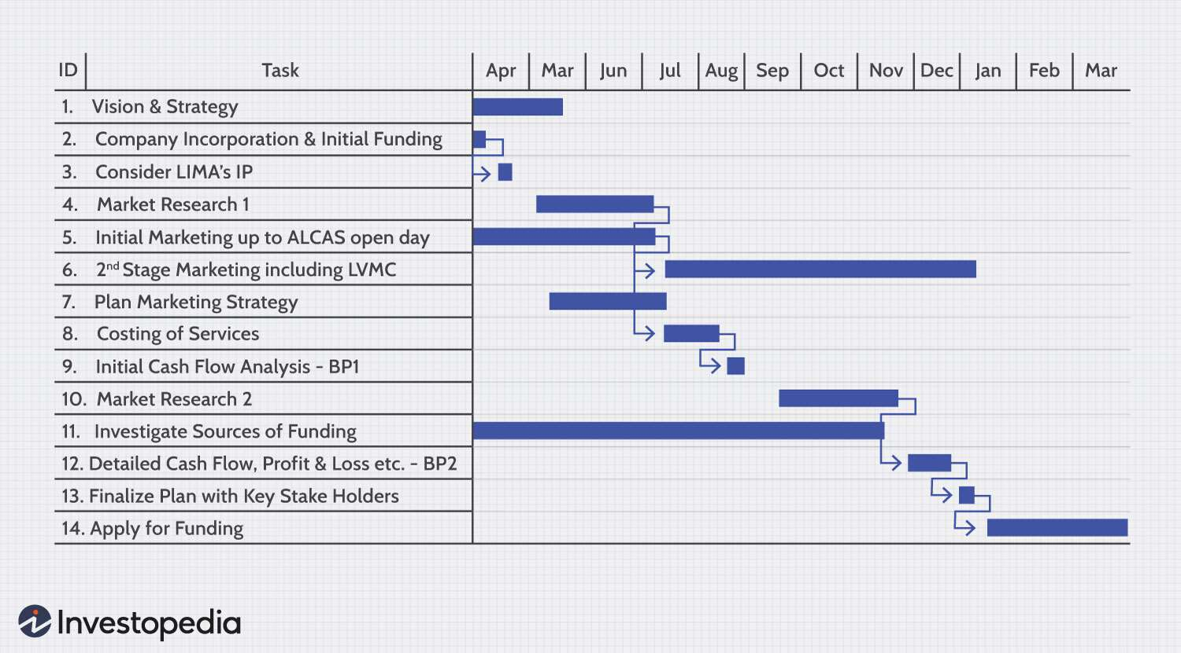
Gantt Chart

Slide 14
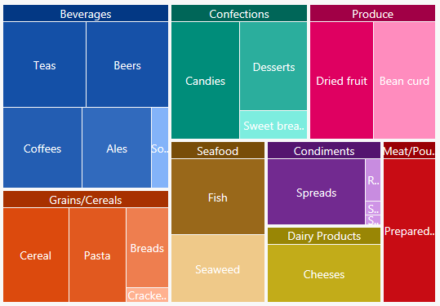

Slide 15
Problem with “just” using Excel
Limited rows
Slow in opening large files
Cannot streamline “pipe” input & output from and to other processing
Often we just need one line of command to finish
E.g. `cat XXX.gtf | awk '$3=="gene"'| cut -f9 | sed 's/.*gene_id=\([^;]*\)*.*/\1/g' | sort -u`
extracts unique gene IDs from the entire GTF annotation
On Excel, you may need many clicks and “save as" and open for the same action
Less versatile processing functions
May inadvertently have data changed automatically by Excel formatting
e.g. “gene symbols such as SEPT2 (Septin 2) and
MARCH1 [Membrane-Associated Ring Finger (C3HC4) 1,
E3 Ubiquitin Protein Ligase] are converted by default to ‘2-Sep’ and ‘1-Mar’”
9

Slide 16
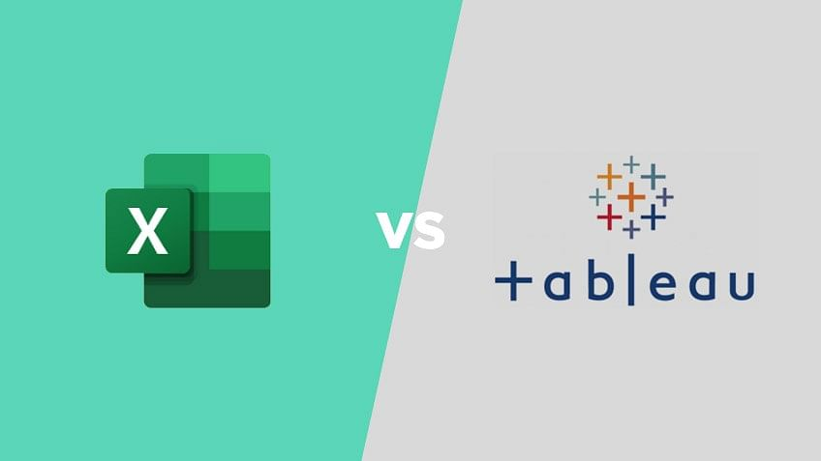
Excel VS Tableau
Microsoft Excel is a spreadsheet application used for calculations, statistical operations, data analysis, and reporting.
Tableau is a business intelligence and data visualization tool to get insights from data, find hidden trends, and make business decisions.
Excel works well when we have to create quick, one-off reports.
Tableau is helpful when we want a more detailed analysis of your business reports.

Slide 17

Tableau Download
https://www.tableau.com/academic/students

Slide 18
Data Analysis and Visaulisation with ML
A branch of artificial intelligence, concerned with the design and development of algorithms that allow computers to evolve behaviors based on empirical data.
As intelligence requires knowledge, it is necessary for the computers to acquire knowledge.

Slide 19
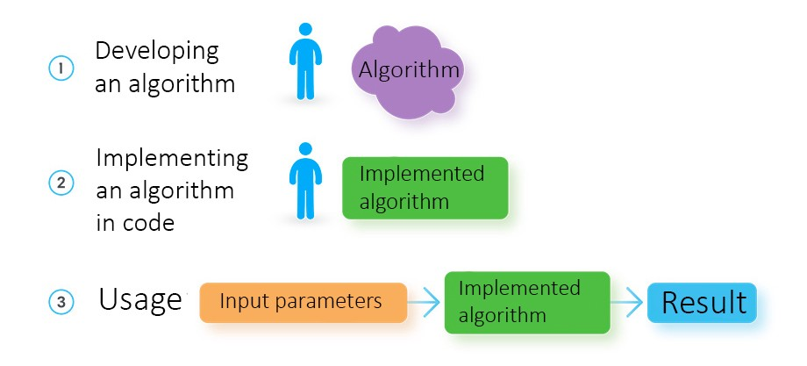
How a software developer creates a solution

Slide 20
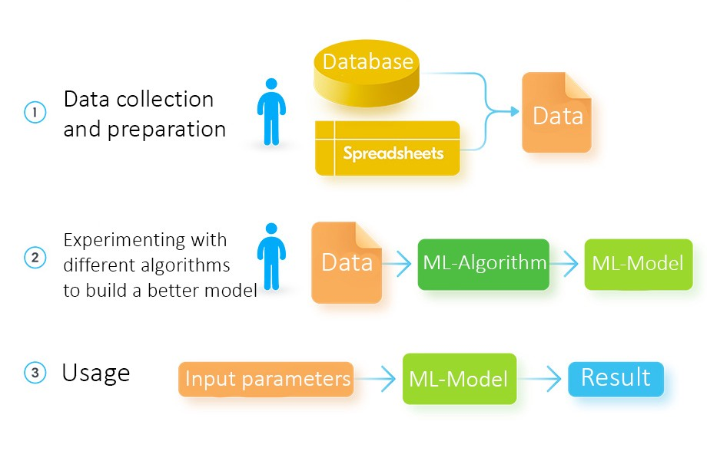
How a data engineer develops a solution using Machine Learning

Slide 21
What is Machine Learning?
Aspect of AI: creates knowledge
Definition:
“changes in [a] system that ... enable [it] to do the same task or tasks drawn from the same population more efficiently and more effectively the next time.'' (Simon 1983)
There are two ways that a system can improve:
1. By acquiring new knowledge
acquiring new facts
acquiring new skills
2. By adapting its behavior
solving problems more accurately
solving problems more efficiently

Slide 22
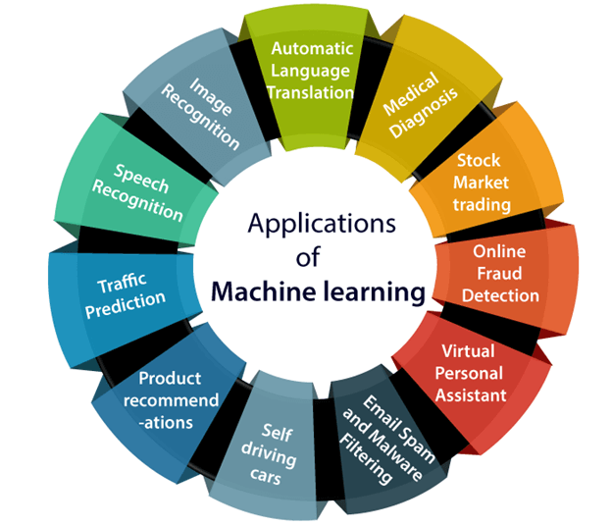
Applications of Machine learning
Machine learning is a buzzword for today's technology, and it is growing very rapidly day by day.
We are using machine learning in our daily life even without knowing it such as Google Maps, Google assistant, Alexa, etc.

Slide 23

Real-World Applications
With the rise in big data, machine learning has become particularly important for solving problems in areas like these:
Computational finance, for credit scoring and algorithmic trading
Image processing and computer vision, for face recognition, motion detection, and object detection
Computational biology, for tumor detection, drug discovery, and DNA sequencing
Energy production, for price and load forecasting
Automotive, aerospace, and manufacturing, for predictive maintenance
Natural language processing

Slide 24
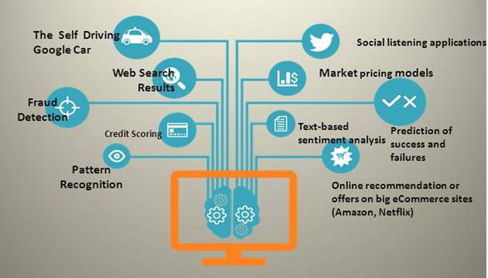
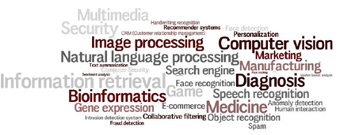
Machine Learning Trends

Slide 25

Machine Learning Trends
“Telephone took 75 years to reach 50 million users, radio 38 yrs, television 13 yrs, Internet 4 yrs, Facebook 19 months, Pokemon Go 19 days. AarogyaSetu, India’s app to fight COVID-19 has reached 50 mn users in just 13 days-fastest ever globally for an App,” Kant said in his tweet.
The app will calculate this based on their interaction with others, using cutting edge Bluetooth technology, algorithms and artificial intelligence.

Slide 26
What Machine Learning can do
Finding which category an object belongs to -- by Classification Algorithm
Finding what is strange -- by Anomaly Detection Algorithm
Finding how much and how many -- by Regression Algorithm
Finding how data is arranged – by Clustering Algorithm
What should I do next -- by Reinforcement Algorithm

Slide 27
History of Machine Learning
1960’s and 70’s: Models of human learning
High-level symbolic descriptions of knowledge, e.g., logical expressions or graphs/networks, e.g., (Karpinski & Michalski, 1966) (Simon & Lea, 1974).
Winston’s (1975) structural learning system learned logic-based structural descriptions from examples.
Minsky Papert, 1969
1970’s: Genetic algorithms
Developed by Holland (1975)
1970’s - present: Knowledge-intensive learning
A tabula rasa approach typically fares poorly. “To acquire new knowledge a system must already possess a great deal of initial knowledge.” Lenat’s CYC project is a good example.

Slide 28
History of Machine Learning (cont’d)
1970’s - present: Alternative modes of learning (besides examples)
Learning from instruction, e.g., (Mostow, 1983) (Gordon & Subramanian, 1993)
Learning by analogy, e.g., (Veloso, 1990)
Learning from cases, e.g., (Aha, 1991)
Discovery (Lenat, 1977)
1991: The first of a series of workshops on Multistrategy Learning (Michalski)
1970’s – present: Meta-learning
Heuristics for focusing attention, e.g., (Gordon & Subramanian, 1996)
Active selection of examples for learning, e.g., (Angluin, 1987), (Gasarch & Smith, 1988), (Gordon, 1991)
Learning how to learn, e.g., (Schmidhuber, 1996)

Slide 29
History of Machine Learning (cont’d)
1980 – The First Machine Learning Workshop was held at Carnegie-Mellon University in Pittsburgh.
1980 – Three consecutive issues of the International Journal of Policy Analysis and Information Systems were specially devoted to machine learning.
1981 - Hinton, Jordan, Sejnowski, Rumelhart, McLeland at UCSD
Back Propagation alg. PDP Book
1986 – The establishment of the Machine Learning journal.
1987 – The beginning of annual international conferences on machine learning (ICML). Snowbird ML conference
1988 – The beginning of regular workshops on computational learning theory (COLT).
1990’s – Explosive growth in the field of data mining, which involves the application of machine learning techniques.

Slide 30
Bottom line from History
1960 – The Perceptron (Minsky Papert)
1960 – “Bellman Curse of Dimensionality”
1980 – Bounds on statistical estimators (C. Stone)
1990 – Beginning of high dimensional data (Hundreds variables)
2000 – High dimensional data (Thousands variables)

Slide 31
How Do You Decide Which Algorithm to Use?
Choosing the right algorithm can seem overwhelming—there are dozens of supervised and unsupervised machine learning algorithms, and each takes a different approach to learning.
There is no best method or one size fits all. Finding the right algorithm is partly just trial and error—even highly experienced data scientists can’t tell whether an algorithm will work without trying it out.
But algorithm selection also depends on the size and type of data you’re working with, the insights you want to get from the data, and how those insights will be used.

Slide 32
Questions to Consider Before You Start
Every machine learning workflow begins with three questions:
What kind of data are you working with?
What insights do you want to get from it?
How and where will those insights be applied?
Your answers to these questions help you decide whether to use supervised or unsupervised learning.

Slide 33
Designing a Learning System
Choose the training experience
Choose exactly what is too be learned, i.e. the target function.
Choose how to represent the target function.
Choose a learning algorithm to infer the target function from the experience.
Learner
Environment/
Experience
Knowledge
Performance
Element

Slide 34
Learning Paradigms
Supervised learning
Generates a function that maps inputs to desired outputs.
For example, in a classification problem, the learner approximates a function mapping a vector into classes by looking at input-output examples of the function
Probably, the most common paradigm
E.g., decision trees, support vector machines, Naïve Bayes, k-Nearest Neighbors, …

Slide 35
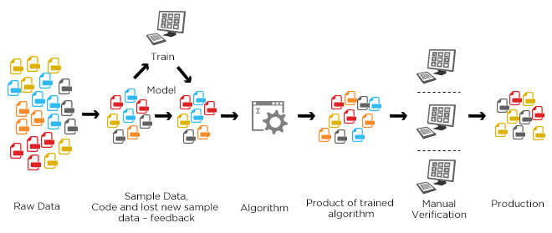
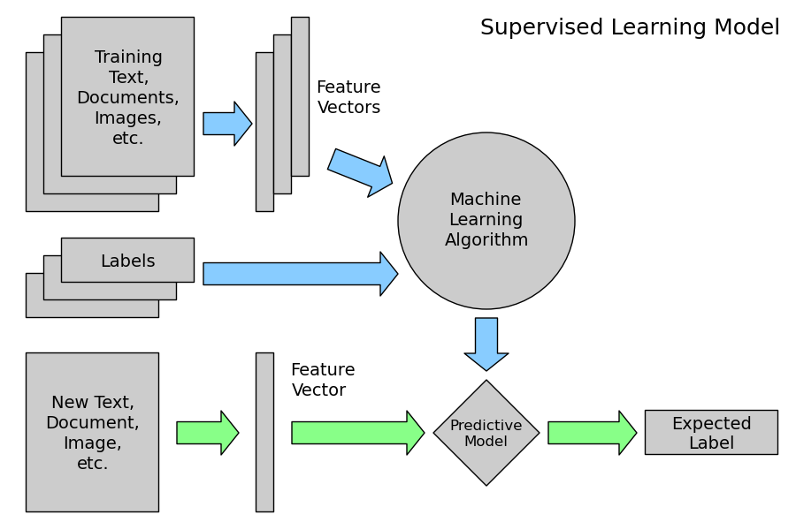
Machine learning structure
Supervised learning

Slide 36
Learning Paradigms
Unsupervised learning
Labels are not known during training
E.g., clustering, association learning
Semi-supervised learning
Combines both labeled and unlabeled examples to generate an appropriate function or classifier
E.g., Transductive Support Vector Machine

Slide 37
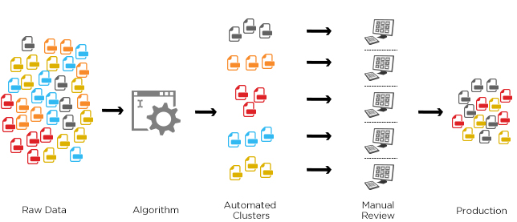
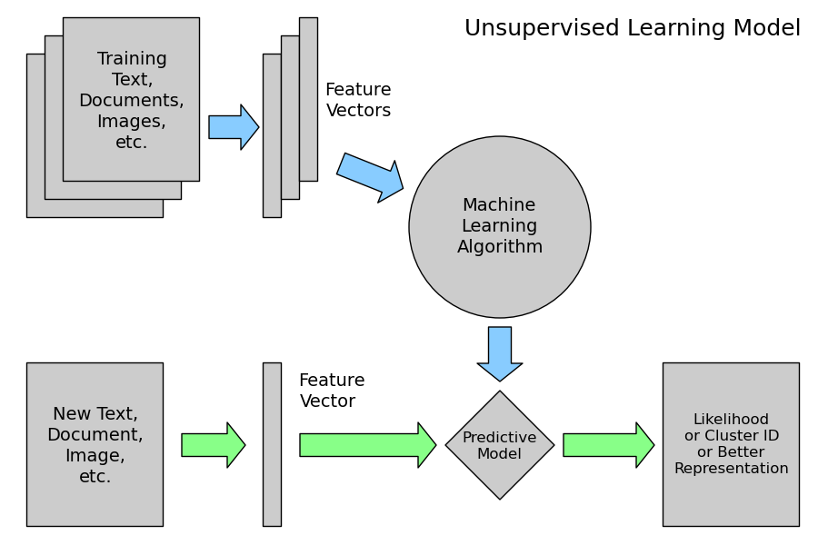
Machine learning structure
Unsupervised learning

Slide 38
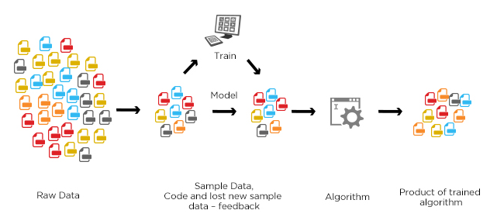
Machine learning structure
semisupervised learning
The goal of a semi-supervised model is to classify some of the unlabeled data using the labeled information set.
Speech Analysis
Protein Sequencing
Web content analysis
Notes:
Auto text expander

Slide 39
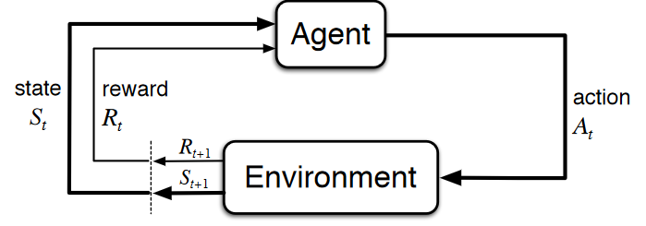
Reinforcement Learning
In the absence of training dataset, it is bound to learn from its experience.
We have an agent and a reward, with many hurdles in between. The agent is supposed to find the best possible path to reach the reward.
Types of Reinforcement: positive, negative, punishment, and extinction.

Slide 40
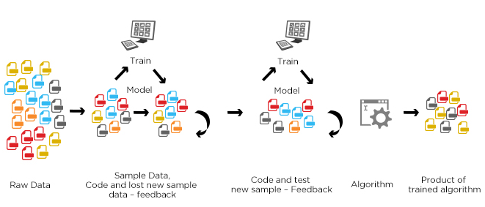
Machine learning structure
Reinforcement learning
It is concerned with how an agent should take actions in an environment so as to maximize some notion of cumulative reward.
Reward given if some evaluation metric improved
Punishment in the reverse case
E.g., Q-learning, Sarsa

Slide 41
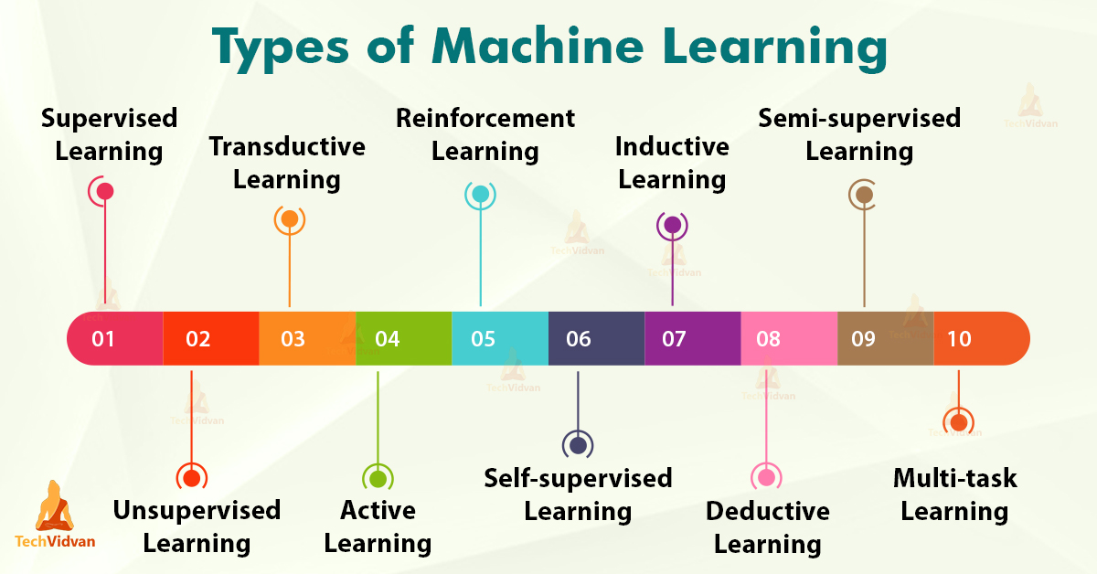

Slide 42
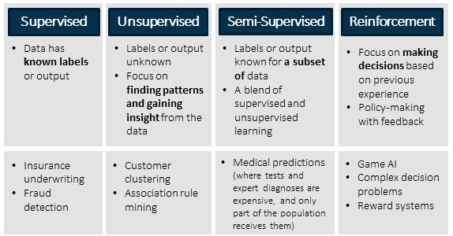
Major Types of Learning

Slide 43
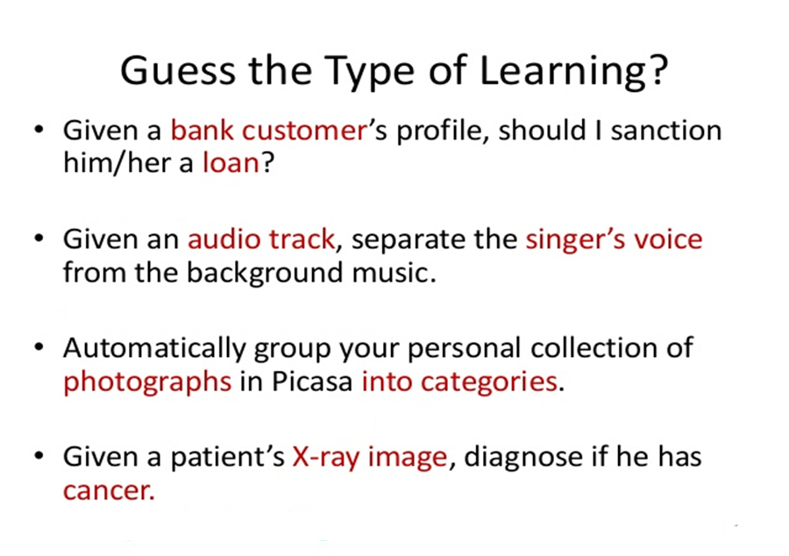

Slide 44
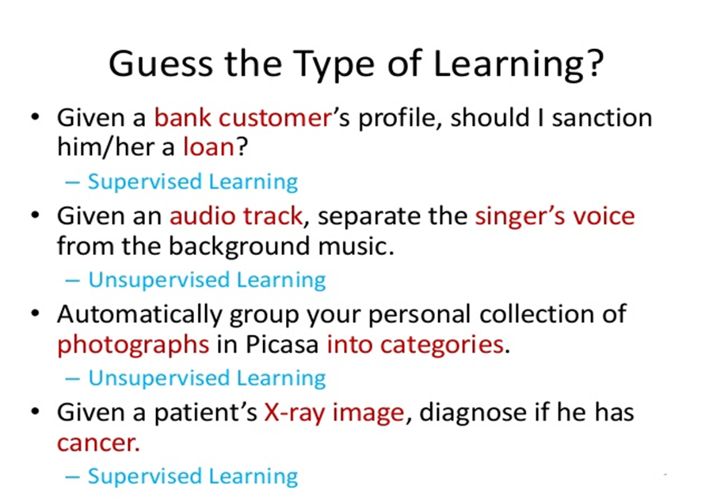

Slide 45
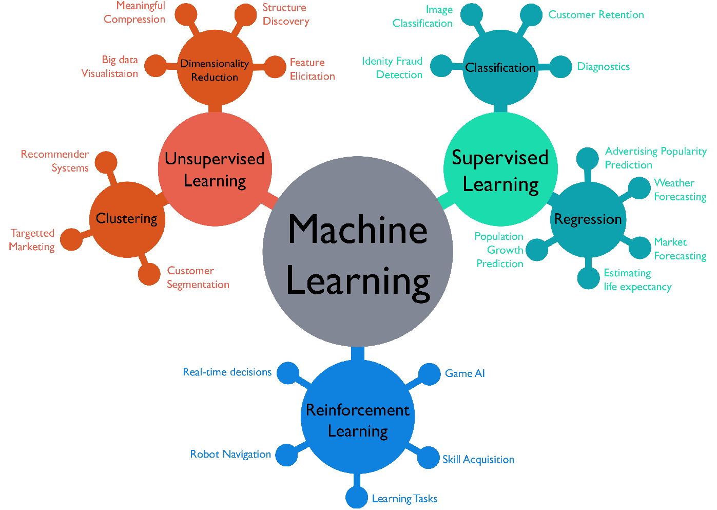
Machine Learning Perspectives

Slide 46
Algorithms
Supervised learning
Prediction
Classification (discrete labels), Regression (real values)
Unsupervised learning
Clustering
Probability distribution estimation
Finding association (in features)
Dimension reduction
Semi-supervised learning
Reinforcement learning
Decision making (robot, chess machine)

Slide 47
ML Algorithms
Classification
Learn a way to classify unseen examples, based on a set of labeled examples, e.g., classify songs by emotion categories. E.g., decision trees (e.g., C5.4)
Regression
Learn a way to predict continuous output values, based on a set of labeled examples, e.g., predict software development effort in person months
Sometimes regarded as numeric classification (outputs are continuous instead of discrete)
E.g., Support Vector Regression

Slide 48
ML Algorithms
Association
Find any association among features, not just input-output associations (e.g., in a supermarket, find that clients who buys apples also buys cereals)
E.g., Apriori
Clustering
Find natural grouping among data
E.g., K-means clustering, DBSCAN, Heirarchial clustering

Slide 49
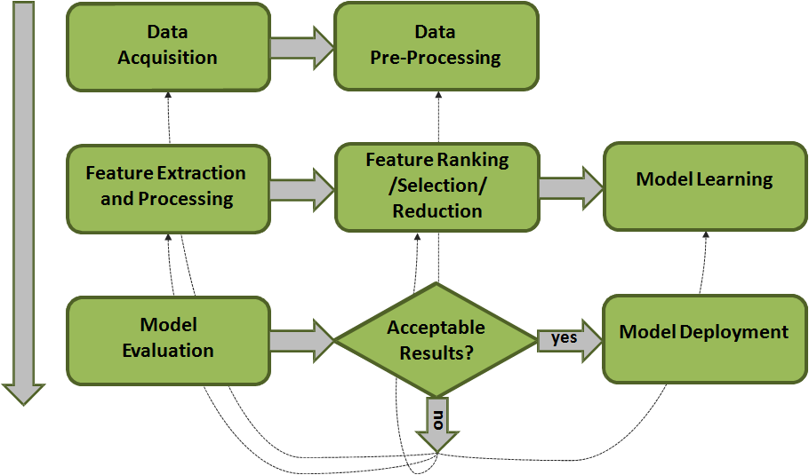
Machine Learning Process

Slide 50
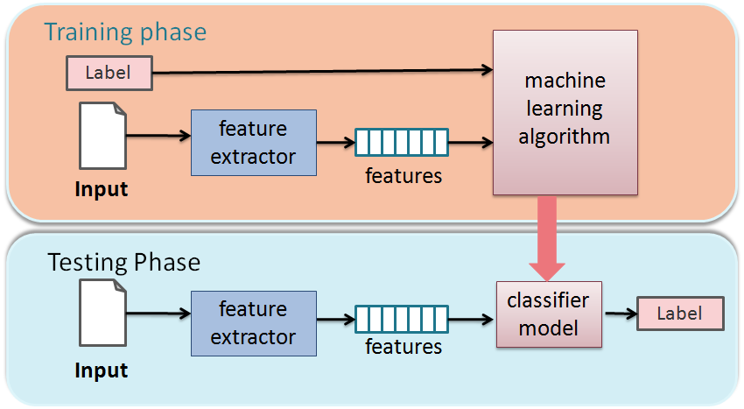
Training and testing
Training is the process of making the system able to learn.
No free lunch rule:
Training set and testing set come from the same distribution
Need to make some assumptions or bias

Slide 51
Performance
There are several factors affecting the performance:
Types of training provided
The form and extent of any initial background knowledge
The type of feedback provided
The learning algorithms used
Two important factors:
Modeling
Optimization

Slide 52
Machine Learning Traditions
Different ML traditions propose different approaches inspired by real-world analogies
Neural networks researchers: emphasize analogies to neurobiology
Case-based learning: human memory
Genetic algorithms: evolution
Rule induction: heuristic search
Analytic methods: reasoning in formal logic
Again, different notation and terminology

Slide 53
Different Varieties of Machine Learning
Concept Learning
Clustering Algorithms
Connectionist Algorithms
Genetic Algorithms
Explanation-based Learning
Transformation-based Learning
Reinforcement Learning
Case-based Learning
Macro Learning
Evaluation Functions
Cognitive Learning Architectures
Constructive Induction
Discovery Systems
Knowledge capture

Slide 54
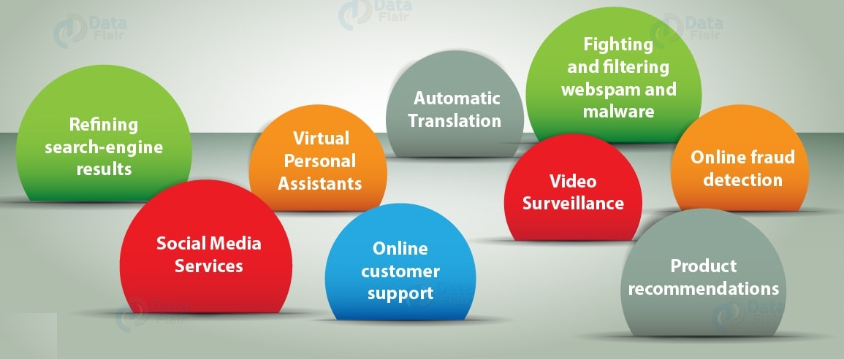
Machine Learning Applications

Slide 55
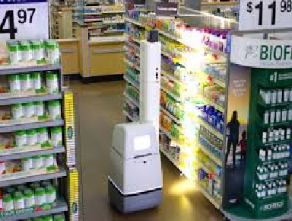
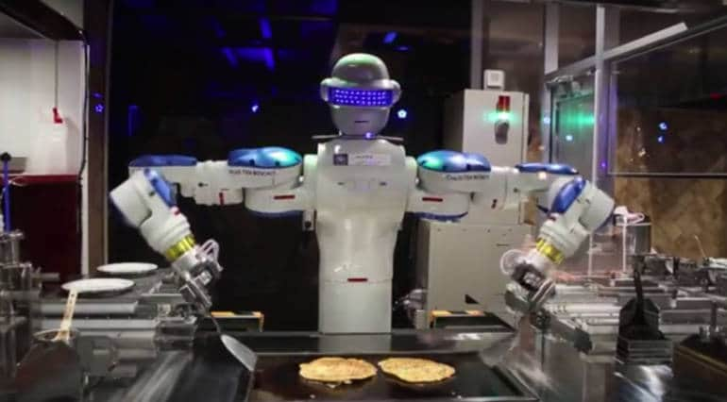

Machine Learning touching our Daily Life
Walmart use Robots in their stores for inventory management, packing, pricing checks
Restaurants have Robot chefs and Waiters

Slide 56
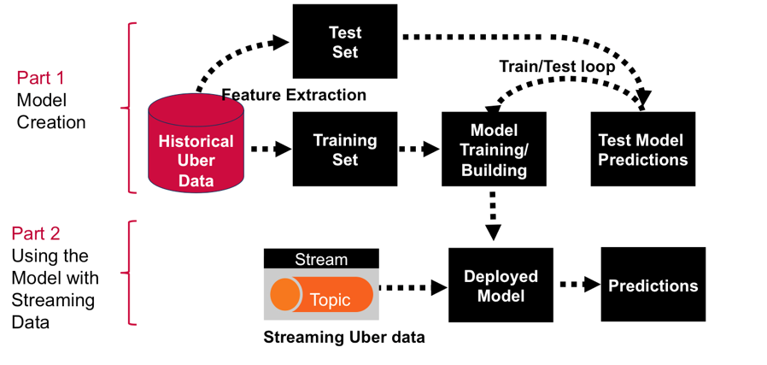

Machine Learning touching our Daily Life
Michelangelo, an internal ML-as-a-service platform that democratizes machine learning and makes scaling AI to meet the needs of business as easy as requesting a ride.

Slide 57



Machine Learning touching our Daily Life
Song Recommendations based on mood and interest
Data Acquisition from Tamr – Enterprise Data Unification Company
Content specific vaccines for Children

Slide 58

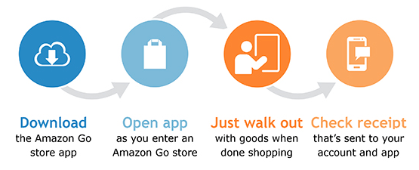
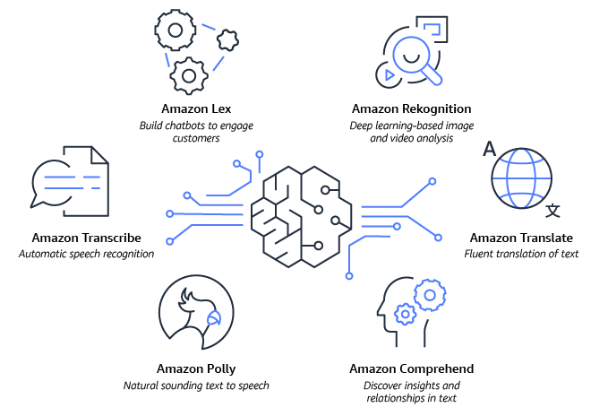
Amazon – Game Changer of the Decade

Slide 59
Machine Learning in Civil Engineering
Design of Construction Management System
Prediction of the Severity of Earthquakes
Better analysis of monitoring the construction health
Analysis of Environmental Engineering
Design of Highway and transportation Engineering fo the prediction of Transport arrivals and pedestrian movement analysis
Use of Machine learning in surveying, Geotechnical and Geospatial Engineering

Slide 60
Machine Learning in Mechanical Engineering
Cognitive Science of a Machine
Use of IoT and Big Data Analytics
On site performance of devices
Non-linear root cause analysis
Tools for analytics and operations

Slide 61
AI for automatically segmenting brain tumors
Artificial Intelligence has a broad scope in healthcare devices and applications.
Makes analysis, treatment, and monitoring of tumors more effective.
NVIDIA has developed a 3D MRI brain tumor segmentation using deep-learning and 3D magnetic resonance imaging technologies.

Slide 62
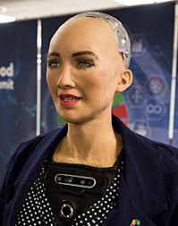

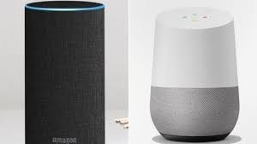

Personalization
Sophia
social humanoid
Google Assistant
Amazon Alexa
Virtual Assistant
Personalization Platforms

Slide 63
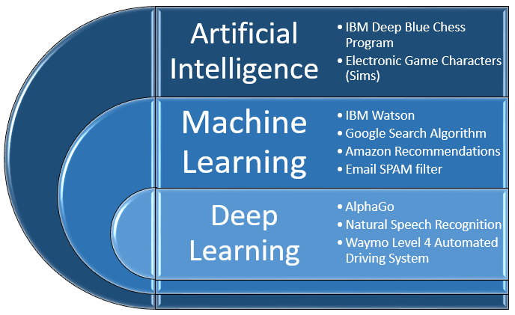
AI vs Machine Learning vs Deep Learning
Programs with the ability to learn and reason like humans
Algorithms with the ability to learn without being explicitly programmed
Subset of Machine Learning in which Artificial Neural Networks adapt and learn from vast amounts of data.

Slide 64
Future of machine learning
Improved unsupervised algorithms
Enhanced personalization
Increased adoption of quantum computing
Improved cognitive services
Rise of robots

Slide 65
Top Machine Learning Software Tools
Software | Platform | Written in language | Algorithms or Features
Scikit Learn | Linux, Mac OS, Windows | Python, Cython, C, C++ | Classification, Regression Clustering, Preprocessing Model Selection Dimensionality reduction.
PyTorch | Linux, Mac OS, Windows | Python, C++, CUDA | Autograd Module, Optim Module, nn Module
TensorFlow | Linux, Mac OS, Windows | Python, C++, CUDA | Provides a library for dataflow programming.
Weka Waikato Environment for Knowledge Analysis | Linux, Mac OS, Windows | Java | Data preparation, Classification Regression, Clustering Visualization, Association rules mining

Slide 66
Top Machine Learning Software Tools
Software | Platform | Written in language | Algorithms or Features
KNIME Konstanz Information Miner | Linux, Mac OS, Windows | Java | Can work with large data volume. Supports text mining & image mining through plugins
Colab | Cloud Service | - | Supports libraries of PyTorch, Keras, TensorFlow, and OpenCV
Apache Mahout | Cross-platform | Java Scala | Preprocessors, Regression Clustering, Recommenders Distributed Linear Algebra.
Accors.Net | Cross-platform | C# | Classification, Regression, Distribution, Clustering Hypothesis Tests & Kernel Methods, Image, Audio & Signal. & Vision

Slide 67
Top Machine Learning Software Tools
Software | Platform | Written in language | Algorithms or Features
Shogun | Windows Linux UNIX Mac OS | C++ | Regression, Classification Clustering, Support vector machines, Dimensionality reduction, Online learning etc.
Keras.io | Cross-platform | Python | API for neural networks , supports CNN
Rapid Miner | Cross-platform | Java | Data loading & Transformation Data preprocessing & visualization.
Oryx2 | Cross Platform | Python | collaborative filtering, classification, regression , DL, CNN

Slide 68

ML Programming Languages: Some History
“Over six years ago, in December 1989, I was looking for a "hobby" programming project that would keep me occupied during the week around Christmas…I chose Python as a working title for the project, being in a slightly irreverent mood (and a big fan of Monty Python's Flying Circus).”
–Python creator Guido Van Rossum, from the foreward to Programming Python (1st ed.)
Goals:
An easy and intuitive language just as powerful as major competitors
Open source, so anyone can contribute to its development
Code that is as understandable as plain English
Suitability for everyday tasks, allowing for short development times

Slide 69
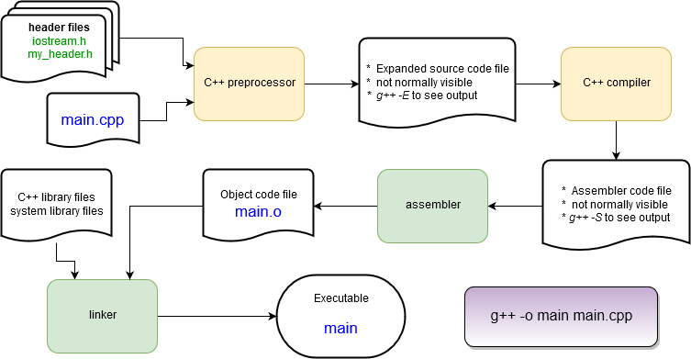
Compiled Languages
(ex. C++ or Fortran)

Slide 70

Interpreted Languages
(ex. Python or R)
bytecode conversion
Python interpreter: follows bytecode instructions
Source code files
prog.py math.py
Python interpreter
python prog.py
A lot less work is done to get a program to start running compared with compiled
languages!
Python programs start running immediately – no waiting for the compiler to finish.
Bytecodes are an internal representation of the text program that can be efficiently run by the Python interpreter.
The interpreter itself is written in C and is a compiled program.

Slide 71
Python for Data Analysis and Visualisation

Slide 72
Getting Python for Yourself: Anaconda
The most popular setup for personal computers
https://www.anaconda.com/download/
Anaconda is a packaged set of programs including the Python language, a huge number of libraries, and several tools.
These include the Spyder development environment and Jupyter notebooks.

Slide 73
Operators
Python supports a wide variety of operators which act like functions, i.e.
they do something and return a value:
Arithmetic: Logical: | + and | - or | * / not | // | % | **
Comparison: | > | < |  | >= | <= | != ==
Assignment: | =
Bitwise: | & | | | ~ ^ | >> | <<
Identity: | is | is not
Membership: | in | not in

Slide 74

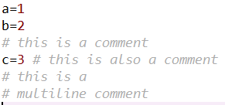
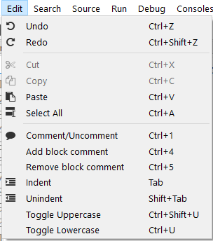
Comments
# is the Python comment character. On any line everything after the # character is ignored by Python.
There is no multi-line comment
character as in C or C++.
An editor like Spyder makes it very easy to comment blocks of code or vice- versa. Check the Edit menu

Slide 75

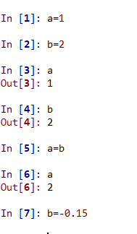
Variables
Variables refer to a value stored in memory and are created when first
assigned
Variables are assigned values using the = operator
In the Python console, typing the name of a variable prints its value
Not true in a script!
Visualize Assignment
Variables can be reassigned at any time
Variable type is not specified
Types can be changed with a reassignment
Variable names:
Must begin with a letter (a - z, A - Z) or underscore _
Other characters can be letters, numbers or _
Are case sensitive: capitalization counts!
Can be any reasonable length

Slide 76
Variable Data Types
Numbers | Integers and floating point (64-bit)
Complex numbers | x = complex(3,1) or x = 3+1j
Strings | "cat" or 'dog'
Boolean | True or False
Lists, dictionaries, sets, and tuples | These hold collections of values
Specialty types | Files, network connections, etc.
Custom types | User- or library-defined types using Python classes
x = comple
x(3,1) x = 3+1j

Slide 77
Variable modifying operators
Some additional arithmetic operators that modify variable values:
Operator | Effect | Equivalent to…
x += y | Add the value of y to x | x = x + y
x -= y | Subtract the value of y from x | x = x - y
x *= y | Multiply the value of x by y | x = x * y
x /= y | Divide the value of x by y | x = x / y
The += operator is by far the most used of these.

Slide 78

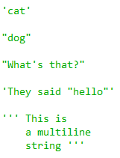
Strings
Strings are a basic data type in Python.
Indicated using pairs of single '' or double "" quotes.
Multiline strings use a triple set of quotes (single or double) to start and end them.
25

Slide 79

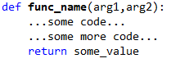
Python Functions
Function name
Optional comma-separated list of arguments (incoming variables)
Keyword def
A code block
Optional return statement
Functions are used to create pieces of code that can be used in a program or in many programs.
The return value can be any Python type
If the return statement is omitted a special None value is still returned.
The arguments are optional but the parentheses are required!
Functions must be defined before they can be called.
Programs that make heavy use of function definitions tend to be easier to: develop, debug, maintain, and understand
Some useful built-in functions… print(), dir(), type(), help()

Slide 80
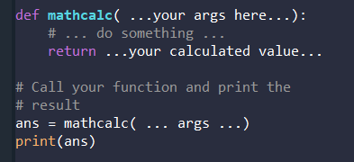
Write a Function
In Spyder’s editor:
Define a function called mathcalc that takes 3 numbers as arguments and returns
their sum divided by their product.
Save the file and run it. Here’s some sample output to check your result. mathcalc(1,2,3) → returns 1.0 mathcalc(4, -2.5, 3.0) → returns -0.15

Slide 81
Which code sample is easier to read?
C
float avg(int a, int b, int c)
{
float sum = a + b + c ; return sum / 3.0 ;
}
Most languages use special characters ({ } pairs) or keywords (end, endif) to indicate sections of code that belong to:
Functions
Control statements like if
Loops like for or while
Python instead uses the indentation that programmers use anyway for readability.
Matlab
function | a | = avg(x,y,z)
a = x | + | y + z ;
a = a end | / | 3.0 ;

Slide 82
Function arguments
Function arguments can be required or optional.
Optional arguments are given a default value
def my_func(a,b,c=10,d=-1):
…some code…
To call a function with optional arguments:
Optional arguments can be used in the order they’re declared or out of order if their name is used.
my_func(x,y) | # | a=x, | b=y, | c=10, | d=-1
my_func(x,y,z) | # | a=x, | b=y, | c=z, | d=-1
my_func(x,y,d=w,c=z) | # | a=x, | b=y, | c=z, | d=w

Slide 83
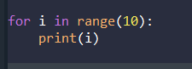
For Loops
For loops are used to repeat commands a specified number of times.
Python has a built-in function to produce a sequence of numbers, range()
range(N) → numbers 0 to (N-1)
range(M, N) → numbers M to (N-1)
range(M, N, P) → numbers M to (N-1) in steps of P
Put that together with a for loop and run commands a specified number of
times:
range(10) → 0…9
Indented code block, can be multiple lines long.
i is first 0, then 1, then 2…

Slide 84


List functions
A Python list is a general purpose 1-dimensional container for variables.
i.e. it is a row, column, or vector of things
Lots of things in Python act like lists or use list-style notation.
Try dir(list_1)
List have a number of built-in functions
Let’s try out a few…
Also try the len() function to see how many things are in the list: len(list_1)

Slide 85
List Indexing
Elements in a list are accessed by an index number.
Index #’s start at 0.
List:
x=['a', 'b', 'c', 'd' ,'e']
First element: | x[0] | → | 'a'
Nth element: | x[2] | → | 'c'
Last element: | x[-1]→ |  | 'e'
Next-to-last: | x[-2]→ |  | 'd'

Slide 86

More on Lists and Variables
What happens when we pass a list to a
function?
Or we do an assignment with it?

Slide 87


If / Else
If, elif, and else statements are used to implement conditional program
behavior
elif and else are not required – use them to chain together multiple conditional statements or provide a default case.
Try out something like this in the Spyder editor.
Do you get any error messages in the console?
Try using an elif or else statement by itself without a preceding if. What error message comes up?

Slide 88
Python Libraries for Data Science
Many popular Python toolboxes/libraries:
NumPy
SciPy
Pandas
SciKit-Learn
Visualization libraries
matplotlib
Seaborn
and many more …
All these libraries are installed on the SCC

Slide 89
Python Classes
class City:
''' A class to hold info about a city '''
def init (self, name, area, pop, num_colleges): self.name = name
self.area = area self.pop = pop
self.num_colleges = num_colleges
def is_best_city(self):
return self.name == 'Boston'
boston = City('Boston', 685094, 232.1, 35)
new_york = City('New York City', 8804190, 1223.59, 120)
print(new_york.is_best_city()) # prints False
OOP: Object Oriented Programming
In OOP a class is a data structure that combines data with functions that operate on that data.
Some familiarity with OOP is needed to understand Python data structures and libraries
An object is a variable whose type is a class
Also called an instance of a class
Classes provide a lot of power to help organize a program and can
improve your ability to re-use your own code.

Slide 90
Syntax for using Python classes
Create an object, which is a variable whose type is a Python class.
Created by a call to the class
or returned from a function.
# Open a file. This returns a file object. file = open('some_file.txt')
# Read all the lines from the text file. # Return them as a list.
lines = file.readlines()
# Get the filename
file.name # --> some_file.txt
Call a method for this object:
object_name.method_name(args…)
Access internal data for this object:
object_name.data_name

Slide 91
Dictionaries
Dictionaries are another basic Python data type that are tremendously
useful.
Create a dictionary with a pair of curly braces:
x = {}
Dictionaries store values and are indexed with keys
Create a dictionary with some initial values:
x = {'a_key':55, 100:'a_value', 4.1:[5,6,7]}

Slide 92

Spyder – a Python development environment
Pros:
Faster development
Easier debugging!
Helps organize code
Cons
Learning curve
Can add complexity to smaller problems

Slide 93
The Spyder IDE
Variable and file explorer
file editor
Python console

Slide 94

Python Libraries for Data Science
NumPy:
introduces objects for multidimensional arrays and matrices, as well as functions that allow to easily perform advanced mathematical and statistical operations on those objects
provides vectorization of mathematical operations on arrays and matrices which significantly improves the performance
many other python libraries are built on NumPy
Link: http://www.numpy.org/

Slide 95

Python Libraries for Data Science
SciPy:
collection of algorithms for linear algebra, differential equations, numerical integration, optimization, statistics and more
part of SciPy Stack
built on NumPy
Link: https://www.scipy.org/scipylib/

Slide 96

Python Libraries for Data Science
Pandas:
adds data structures and tools designed to work with table-like data (similar to Series and Data Frames in R)
provides tools for data manipulation: reshaping, merging, sorting, slicing, aggregation etc.
allows handling missing data
Link: http://pandas.pydata.org/

Slide 97

Python Libraries for Data Science
SciKit-Learn:
provides machine learning algorithms: classification, regression, clustering, model validation etc.
built on NumPy, SciPy and matplotlib
Link: http://scikit-learn.org/

Slide 98

Python Libraries for Data Science
matplotlib:
python 2D plotting library which produces publication quality figures in a variety of hardcopy formats
a set of functionalities similar to those of MATLAB
line plots, scatter plots, barcharts, histograms, pie charts etc.
relatively low-level; some effort needed to create advanced visualization
Link: https://matplotlib.org/

Slide 99
Python Libraries for Data Science
Seaborn:
based on matplotlib
provides high level interface for drawing attractive statistical graphics
Similar (in style) to the popular ggplot2 library in R

Slide 100
Loading Python Libraries with Jupyter
In [ ]:
#Import Python Libraries
import numpy as np
import scipy as sp
import pandas as pd
import matplotlib as mpl
import seaborn as sns
import requests
Press Shift+Enter to execute the jupyter cell

Slide 101
Reading data using pandas
In [ ]:
#Read csv file
df=pd.read_csv("https://github.com/Sibitenda/Masters_MIS/blob/main/Data%20Analysis%20and%20Visualisation/Data/Salaries.csv")
---to avoid errors, use ----
url="https://github.com/Sibitenda/Masters_MIS/blob/main/Data%20Analysis%20and%20Visualisation/Data/Salaries.csv"
raw_url = url.replace("github.com", "raw.githubusercontent.com").replace("/blob/", "/")
df = pd.read_csv(raw_url)
df
There is a number of pandas commands to read other data formats:
pd.read_excel('myfile.xlsx',sheet_name='Sheet1', index_col=None, na_values=['NA'])
pd.read_stata('myfile.dta')
pd.read_sas('myfile.sas7bdat')
pd.read_hdf('myfile.h5','df')

Slide 102

Exploring data frames
In [3]:
#List first 5 records
df.head()
Out[3]:

Slide 103

Hands-on exercises
Try to read the first 10, 20, 50 records;
Can you guess how to view the last few records; Hint:

Slide 104
Data Frame data types
Pandas Type | Native Python Type | Description
object | string | The most general dtype. Will be assigned to your column if column has mixed types (numbers and strings).
int64 | int | Numeric characters. 64 refers to the memory allocated to hold this character.
float64 | float | Numeric characters with decimals. If a column contains numbers and NaNs(see below), pandas will default to float64, in case your missing value has a decimal.
datetime64, timedelta[ns] | N/A (but see the datetime module in Python’s standard library) | Values meant to hold time data. Look into these for time series experiments.

Slide 105
Data Frame data types
In [4]:
#Check a particular column type
df['salary'].dtype
Out[4]: dtype('int64')
In [5]:
#Check types for all the columns
df.dtypes
Out[4]:
object
object
int64
int64
object
int64
rank
discipline
phd
service
sex
salary
dtype: object

Slide 106
Data Frames attributes
Python objects have attributes and methods.
df.attribute | description
dtypes | list the types of the columns
columns | list the column names
axes | list the row labels and column names
ndim | number of dimensions
size | number of elements
shape | return a tuple representing the dimensionality
values | numpy representation of the data

Slide 107
Hands-on exercises
Find how many records this data frame has;
How many elements are there?
What are the column names?
What types of columns we have in this data frame?

Slide 108
Data Frames methods
Unlike attributes, python methods have parenthesis.
All attributes and methods can be listed with a dir() function: dir(df)
df.method() | description
head( [n] ), tail( [n] ) | first/last n rows
describe() | generate descriptive statistics (for numeric columns only)
max(), min() | return max/min values for all numeric columns
mean(), median() | return mean/median values for all numeric columns
std() | standard deviation
sample([n]) | returns a random sample of the data frame
dropna() | drop all the records with missing values

Slide 109
Hands-on exercises
Give the summary for the numeric columns in the dataset
Calculate standard deviation for all numeric columns;
What are the mean values of the first 50 records in the dataset? Hint: use head() method to subset the first 50 records and then calculate the mean

Slide 110
Selecting a column in a Data Frame
Method 1: Subset the data frame using column name:
df['sex']
Method 2: Use the column name as an attribute:
df.sex
Note: there is an attribute rank for pandas data frames, so to select a column with a name "rank" we should use method 1.

Slide 111
Hands-on exercises
Calculate the basic statistics for the salary column;
Find how many values in the salary column (use count method);
Calculate the average salary;

Slide 112

Data Frames groupby method
Using "group by" method we can:
Split the data into groups based on some criteria
Calculate statistics (or apply a function) to each group
Similar to dplyr() function in R
In [ ]:
#Group data using rank
df_rank = df.groupby(['rank'])
In [ ]:
#Calculate mean value for each numeric column per each group
df_rank.mean()

Slide 113

Data Frames groupby method
Once groupby object is create we can calculate various statistics for each group:
In [ ]:
#Calculate mean salary for each professor rank:
df.groupby('rank')[['salary']].mean()
Note: If single brackets are used to specify the column (e.g. salary), then the output is Pandas Series object. When double brackets are used the output is a Data Frame

Slide 114
Data Frames groupby method
groupby performance notes:
- no grouping/splitting occurs until it's needed. Creating the groupby object only verifies that you have passed a valid mapping
- by default the group keys are sorted during the groupby operation. You may want to pass sort=False for potential speedup:
In [ ]:
#Calculate mean salary for each professor rank:
df.groupby(['rank'], sort=False)[['salary']].mean()

Slide 115
Data Frame: filtering
To subset the data we can apply Boolean indexing. This indexing is commonly known as a filter. For example if we want to subset the rows in which the salary value is greater than $120K:
In [ ]:
#Calculate mean salary for each professor rank:
df_sub = df[ df['salary'] > 120000 ]
Any Boolean operator can be used to subset the data:
> greater; >= greater or equal;
< less; <= less or equal;
== equal; != not equal;
In [ ]:
#Select only those rows that contain female professors:
df_f = df[ df['sex'] == 'Female' ]

Slide 116
Data Frames: Slicing
There are a number of ways to subset the Data Frame:
one or more columns
one or more rows
a subset of rows and columns
Rows and columns can be selected by their position or label

Slide 117
Data Frames: Slicing
When selecting one column, it is possible to use single set of brackets, but the resulting object will be a Series (not a DataFrame):
In [ ]:
#Select column salary:
df['salary']
When we need to select more than one column and/or make the output to be a DataFrame, we should use double brackets:
In [ ]:
#Select column salary:
df[['rank','salary']]

Slide 118
Data Frames: Selecting rows
If we need to select a range of rows, we can specify the range using ":"
In [ ]:
#Select rows by their position:
df[10:20]
Notice that the first row has a position 0, and the last value in the range is omitted:
So for 0:10 range the first 10 rows are returned with the positions starting with 0 and ending with 9

Slide 119

Data Frames: method loc
If we need to select a range of rows, using their labels we can use method loc:
In [ ]:
#Select rows by their labels:
df_sub.loc[10:20,['rank','sex','salary']]
Out[ ]:

Slide 120

Data Frames: method iloc
If we need to select a range of rows and/or columns, using their positions we can use method iloc:
In [ ]:
#Select rows by their labels:
df_sub.iloc[10:20,[0, 3, 4, 5]]
Out[ ]:

Slide 121
Data Frames: method iloc (summary)
df.iloc[0] # First row of a data frame
df.iloc[i] #(i+1)th row
df.iloc[-1] # Last row
df.iloc[:, 0] # First column
df.iloc[:, -1] # Last column
df.iloc[0:7] #First 7 rows
df.iloc[:, 0:2] #First 2 columns
df.iloc[1:3, 0:2] #Second through third rows and first 2 columns
df.iloc[[0,5], [1,3]] #1st and 6th rows and 2nd and 4th columns

Slide 122

Data Frames: Sorting
We can sort the data by a value in the column. By default the sorting will occur in ascending order and a new data frame is return.
In [ ]:
# Create a new data frame from the original sorted by the column Salary
df_sorted = df.sort_values( by ='service')
df_sorted.head()
Out[ ]:

Slide 123

Data Frames: Sorting
We can sort the data using 2 or more columns:
In [ ]:
df_sorted = df.sort_values( by =['service', 'salary'], ascending = [True, False])
df_sorted.head(10)
Out[ ]:

Slide 124

Missing Values
Missing values are marked as NaN
In [ ]:
# Read a dataset with missing values
flights=pd.read_csv("https://github.com/Sibitenda/Masters_MIS/blob/main/Data%20Analysis%20and%20Visualisation/Data/flights.csv")
In [ ]:
# Select the rows that have at least one missing value
flights[flights.isnull().any(axis=1)].head()
Out[ ]:

Slide 125
Missing Values
There are a number of methods to deal with missing values in the data frame:
df.method() | description
dropna() | Drop missing observations
dropna(how='all') | Drop observations where all cells is NA
dropna(axis=1, how='all') | Drop column if all the values are missing
dropna(thresh = 5) | Drop rows that contain less than 5 non-missing values
fillna(0) | Replace missing values with zeros
isnull() | returns True if the value is missing
notnull() | Returns True for non-missing values

Slide 126
Missing Values
When summing the data, missing values will be treated as zero
If all values are missing, the sum will be equal to NaN
cumsum() and cumprod() methods ignore missing values but preserve them in the resulting arrays
Missing values in GroupBy method are excluded (just like in R)
Many descriptive statistics methods have skipna option to control if missing data should be excluded . This value is set to True by default (unlike R)

Slide 127
Aggregation Functions in Pandas
Aggregation - computing a summary statistic about each group, i.e.
compute group sums or means
compute group sizes/counts
Common aggregation functions:
min, max
count, sum, prod
mean, median, mode, mad
std, var

Slide 128

Aggregation Functions in Pandas
agg() method are useful when multiple statistics are computed per column:
In [ ]:
flights[['dep_delay','arr_delay']].agg(['min','mean','max'])
Out[ ]:

Slide 129

Examples: Functions

Slide 130


Examples: Loops

Slide 131

Examples: Lists

Slide 132

Examples: If-statements

Slide 133


Examples: Classes

Slide 134
Assignment
Choose ONE dataset from below (all on Kaggle):
Netflix Movies and TV Shows: Analyze genres, release years, ratings. Define a Show class and filter family-friendly content
Global Suicide Rates: Compare suicide trends by country/year. Create a CountryStats class & use dictionaries for grouping
Pokémon with Stats: Filter by type or stats, simulate battles. Use inheritance in a Pokemon class
World University Rankings: Rank universities by country/score. Build a University class to track progress
You must include:
At least 2 functions
At least 1 class with a method
Use of loops, lists, and if statements
Use of dictionaries to group or map data
Submission Format:
Python notebook (.ipynb) or script (.py), with clear comments explaining your code

Slide 135
Basic Descriptive Statistics
df.method() | description
describe | Basic statistics (count, mean, std, min, quantiles, max)
min, max | Minimum and maximum values
mean, median, mode | Arithmetic average, median and mode
var, std | Variance and standard deviation
sem | Standard error of mean
skew | Sample skewness
kurt | kurtosis

Slide 136
Introduction to R

Slide 137
Why R?
Most popular environment in statistics and machine learning communities.
Open source, fast growing ecosystem.
Packages for almost everything:
Data processing and cleaning
Data visualization
Interactive web-apps
Typesetting, writing articles and slides
The newest machine learning routines
. . .
Accomplishes the things you might be used to do doing in Stata (data processing, fitting standard models) and those you might be used to doing in Matlab (numerical programming).
High level language that (mostly) avoids having to deal with technicalities.

Slide 138
Alternatives to R
Stata (proprietary): Most popular statistical software in economics, easy to use for standard methods, not a good programming language.
Matlab (proprietary): Numerical programming environment, matrix based. Programming in (base) R is quite similar to Matlab.
Python (open): General purpose programming language, standard in industry, not targeted toward data analysis and statistics, but lots of development for machine learning. More overhead to write relative to R.
Julia (open): New language for numerical programming, fast, increasingly popular in macro / for solving complicated structural models, not geared toward data analysis.

Slide 139
Installing R, RStudio, and tidyverse
Install R: https://cran.rstudio.com/
Install RStudio: https://www.rstudio.com/products/rstudio/download/
Install tidyverse packages: Type in RStudio terminal
install.packages("tidyverse")
You will often install other packages using this command.

Slide 140
Ressources for learning R
An Introduction to R
Complete introduction to base R. My recommended place to get started. https://cran.r-project.org/doc/manuals/r-release/R-intro.pdf
R for Data Science
Introduction to data analysis using R, focused on the tidyverse packages. If your goal is to find a substitute for Stata, start here.
http://r4ds.had.co.nz/
Advanced R
In-depth discussion of programming in R. Read later, if you want to become a good R programmer.
https://adv-r.hadley.nz/

Slide 141
Ressources for data visualization in R
Data Visualization - A Practical Introduction
Textbook on data visualization, using ggplot2. http://socviz.co/
ggplot2 - Elegant Graphics for Data Analysis
In depth discussion of R-package for data vizualization. http://moderngraphics11.pbworks.com/f/ggplot2-Book09hWickham.pdf
An Economist’s Guide to Visualizing Data
Guidelines for good visualizations (not R-specific). https://pubs.aeaweb.org/doi/pdfplus/10.1257/jep.28.1.209
A Layered Grammar of Graphics
The theory behind ggplot2. https://byrneslab.net/classes/biol607/readings/wickham_layered-grammar.pdf

Slide 142
Ressources for learning extensions to R
Programming interactive R-apps using Shiny
Useful if you want to make your methods easy to use for people not familiar with R, or want to include interactive visualizations in web-pages. https://shiny.rstudio.com/articles/
Markdown
A lightweight markup language. https://www.markdownguide.org/
R markdown Integrate code and output into typeset documents and slides. These slides are written in R markdown. https://rmarkdown.rstudio.com/lesson-1.html
RStudio Cheat Sheets
Cheatsheets for numerous packages. https://www.rstudio.com/resources/cheatsheets/

Slide 143
Conclusion
Thank you for attending the tutorial.
Next !!!

